Slide 1
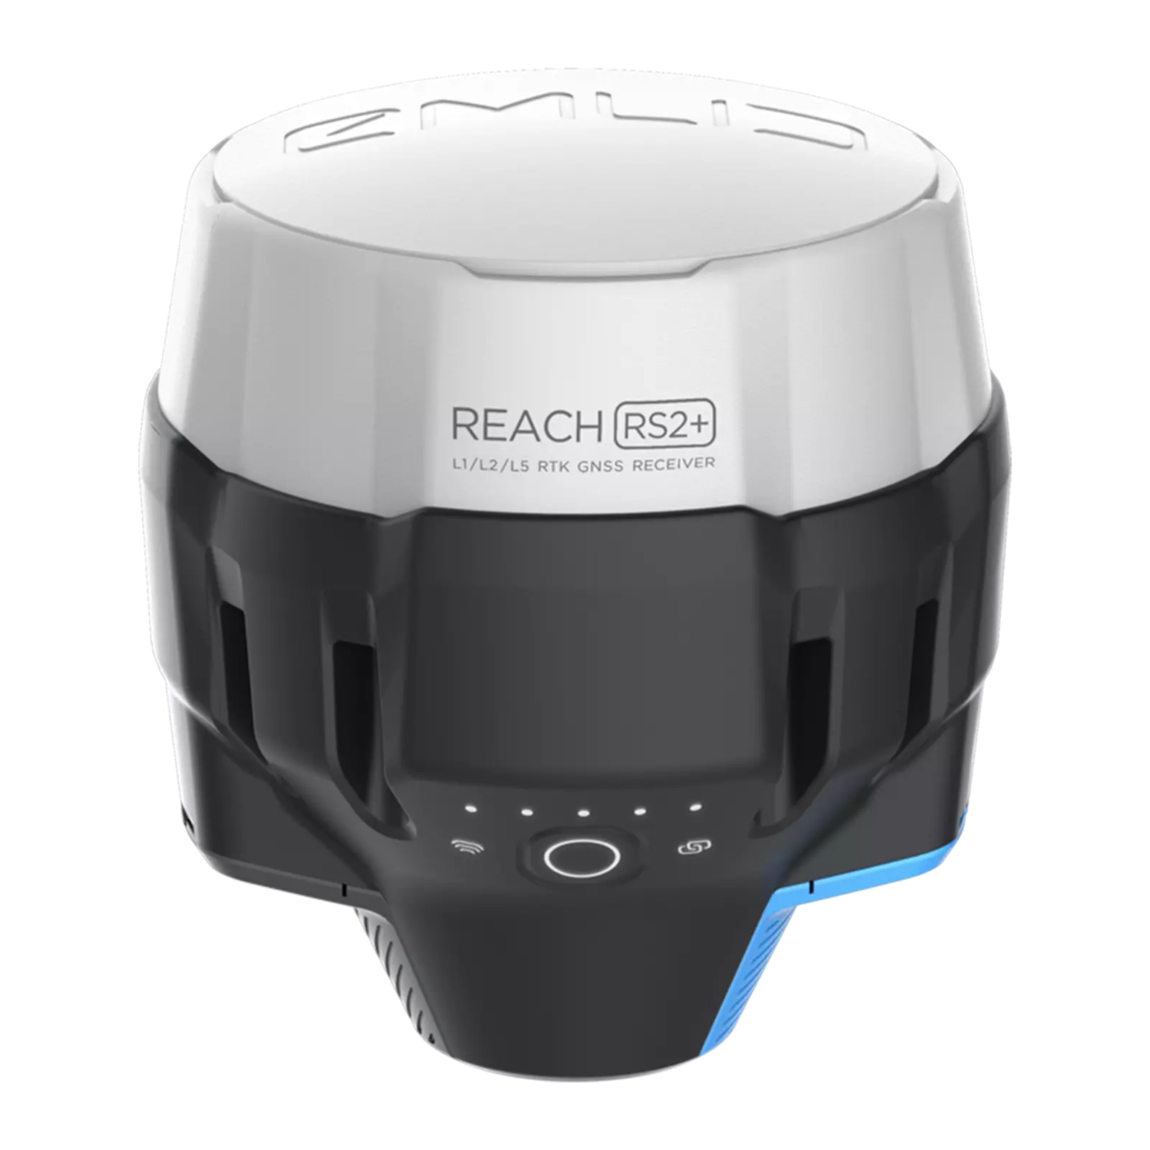
RS2+ RTK GPS
Description
The RS2+ is a high-precision Real-Time Kinematic (RTK) GPS receiver, designed for centimeter-level accuracy in geospatial and navigation applications.
It supports multi-frequency GNSS signals and provides reliable positioning even in challenging environments, such as urban canyons or forests.
Specifications
Connectivity - LoRa, LTE, Wi-Fi, Bluetooth, RS232, USB Type-C
Battery Life - 22 hours on 1 Charge
Operating Temperature : -20 to +65ºC
Ingress Protection - IP67
Applications
Land Surveying
UAV Mapping
Precision Agriculture
Autonomous Navigation
Official Website : https://emlid.com/reachrs2plus/

